Slide 1
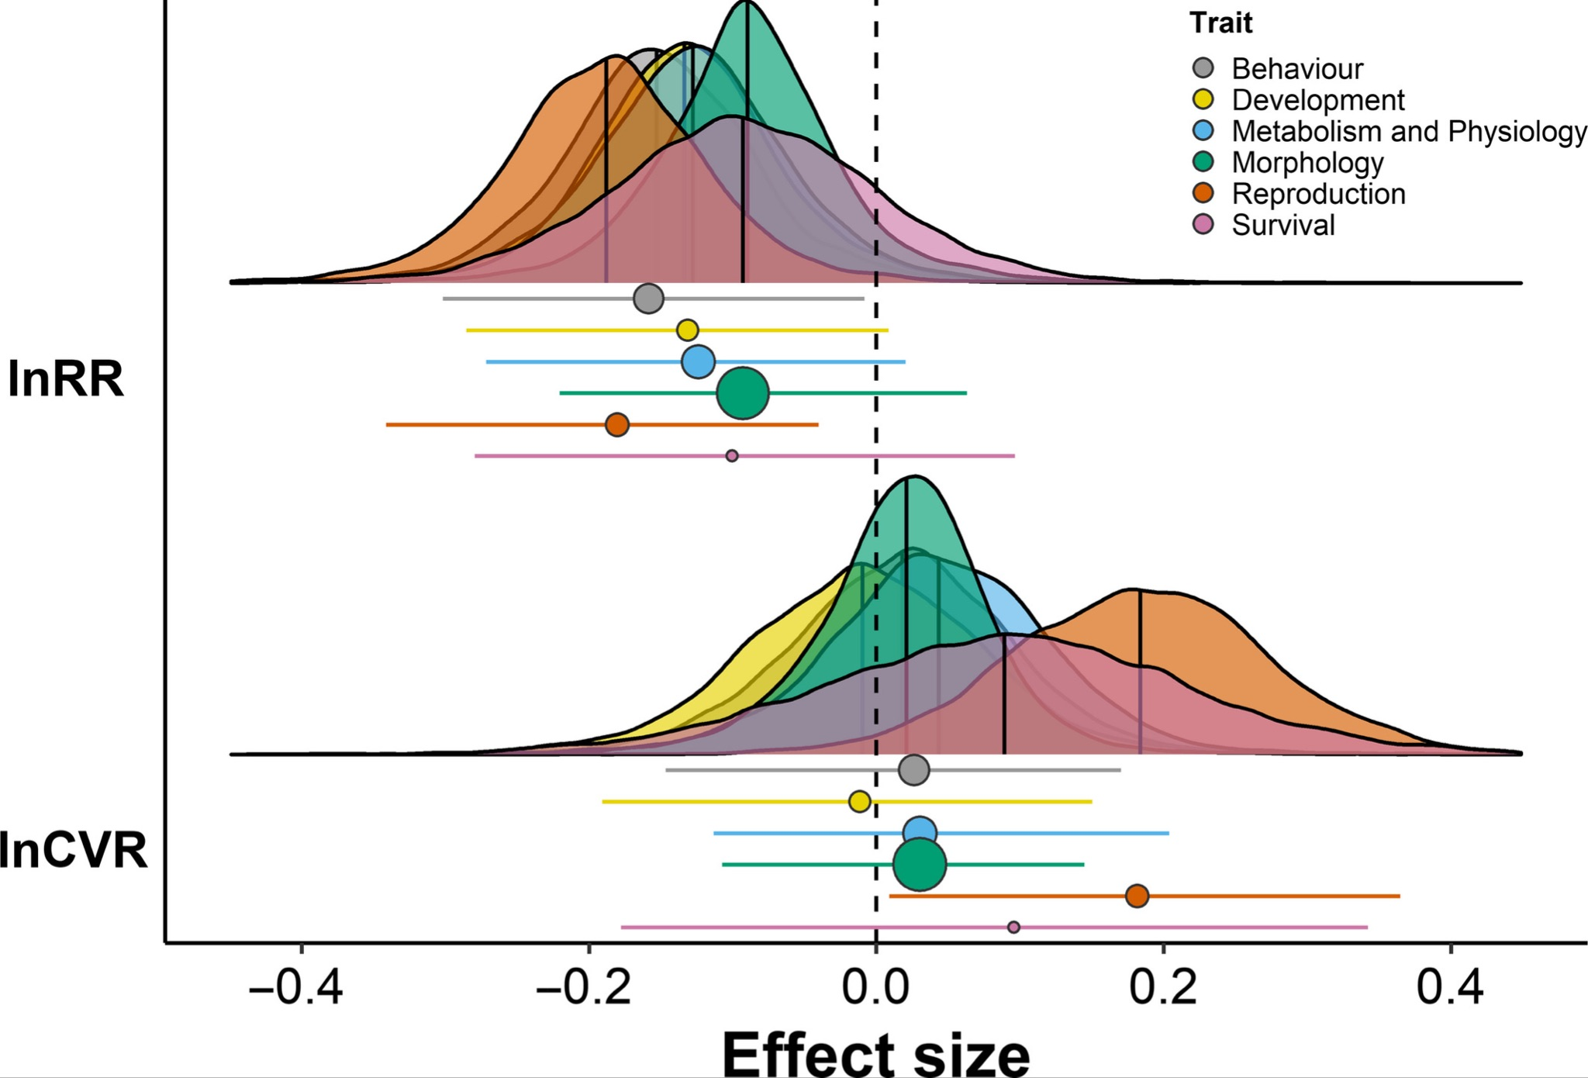
Meta-analysis: Effect sizes, multilevel models and meta-regression

Slide 2
What is a meta-analysis?
Statistical methods and techniques for aggregating, summarizing, and drawing inferences from collections of studies
Part of a Systematic Review
Collate empirical evidence that fits pre-specified eligibility criteria in order to answer a specific research question
Explicit, systematic methods are selected with a view to minimize bias
Provides more reliable findings from which conclusions can be drawn and decisions made

Slide 3
What is an ‘effect size’?
A measure of the magnitude (and direction) of difference, association or central tendency that is comparable across studies
Core unit of analysis in meta-analysis
Have an associated sampling variance

Slide 4

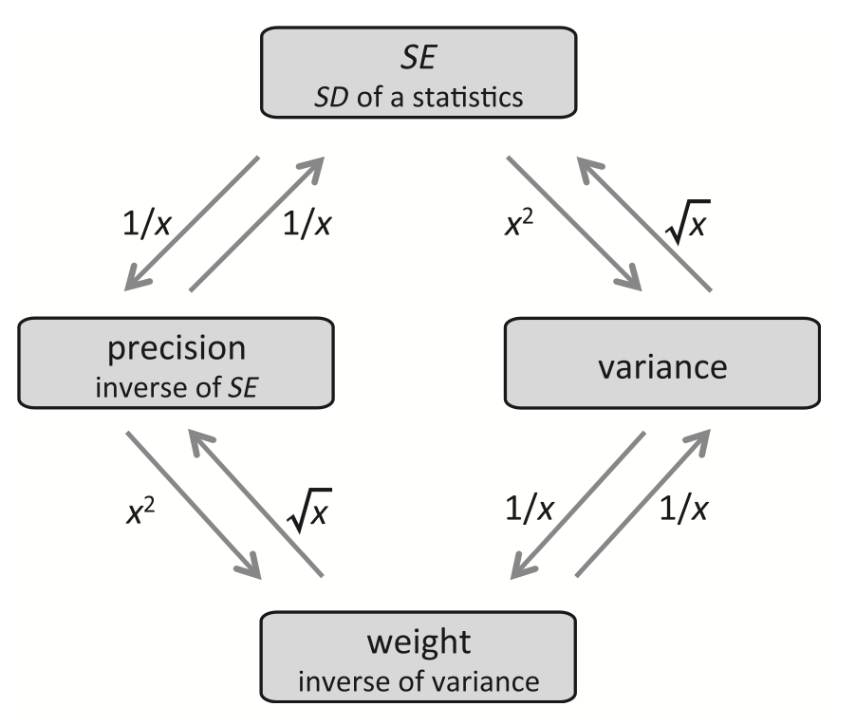
Standard error, standard deviation precision, weights
Standard Error (SE) is the sampling standard deviation of a statistic
Standard Deviation (SD) is the standard deviation of a sample

Slide 5
Meaning of standard error…
means <- c() for (i in 1:1e+06) { tmp <- rnorm(n = 18, mean = 10.8, sd = 0.988) means <- c(tmp, mean(tmp)) } # The mean of the means mean(means)
## [1] 10.79997
# The standard deviation of the means or standard error sd(means)
## [1] 0.2327267

Slide 6
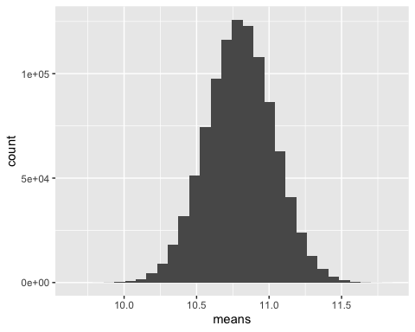
Meaning of standard error…
# The standard error of a sample
se <- sd(tmp)/
sqrt(length(tmp))
## [1] 0.228051
# The standard deviation of the means or standard error sd(means)
## [1] 0.2327267

Slide 7
Different effect size statistics
Data Type
Continuous data
Binary / proportion data
Comparison between means
Odds Ratio (log transformed)
Standardised Mean Difference
Regression Slopes
Pearson’s Correlation
(Z transformed)
Risk ratio
Response ratio
Rate differences

Slide 8
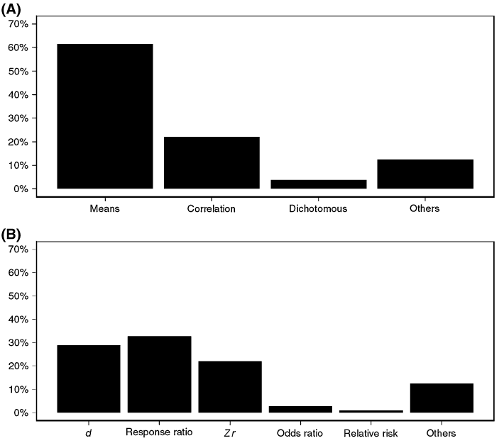
Different effect size statistics
Ecology and Evolution
Nakagawa & Santos (2012); 100 meta-analyses

Slide 9
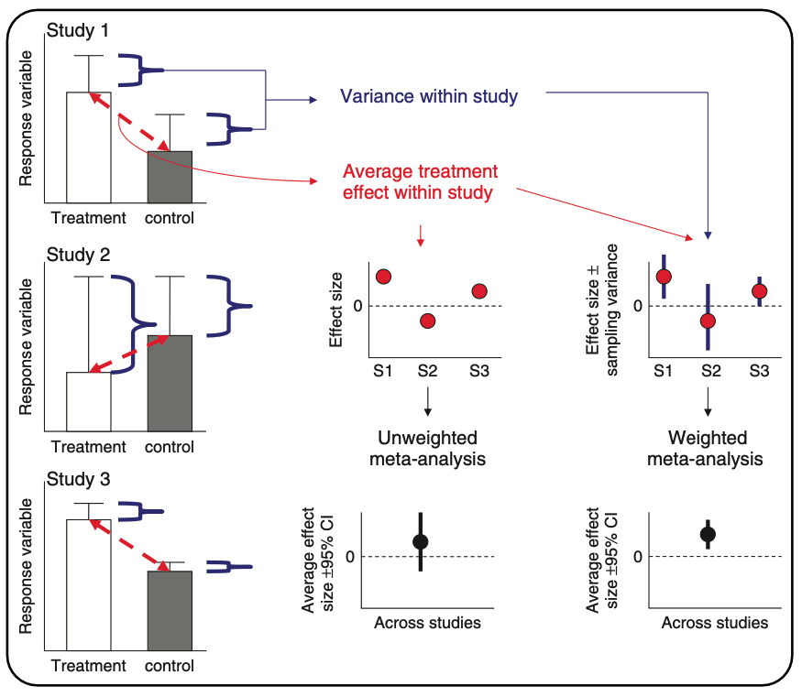
What meta-analysis is doing…
1. Meta-Analysis
Hillebrand & Gurevitch (2016). eLS

Slide 10
Why do we want to do meta-analysis?
Meta-analysis increases power and precision to estimate effects
Individual studies are (often) underpowered
High sampling variability can exaggerate effects; don’t put too much faith in a single study.
Establishes generalities
Explores differences between studies and why they exist
Generates new hypotheses
Helps settle controversies from conflicting empirical studies
Can identify potential publication biases
Identify knowledge gaps to provide guidance for future empirical studies

Slide 11
Three main aims of meta-analysis
Finding generality across studies on the same (similar) topics
Meta-analysis
Subgroup meta-analysis
Finding consistency (inconsistency) among studies
Heterogeneity analysis
Explaining variation in effects
Meta-regression
Publication-bias tests

Slide 12
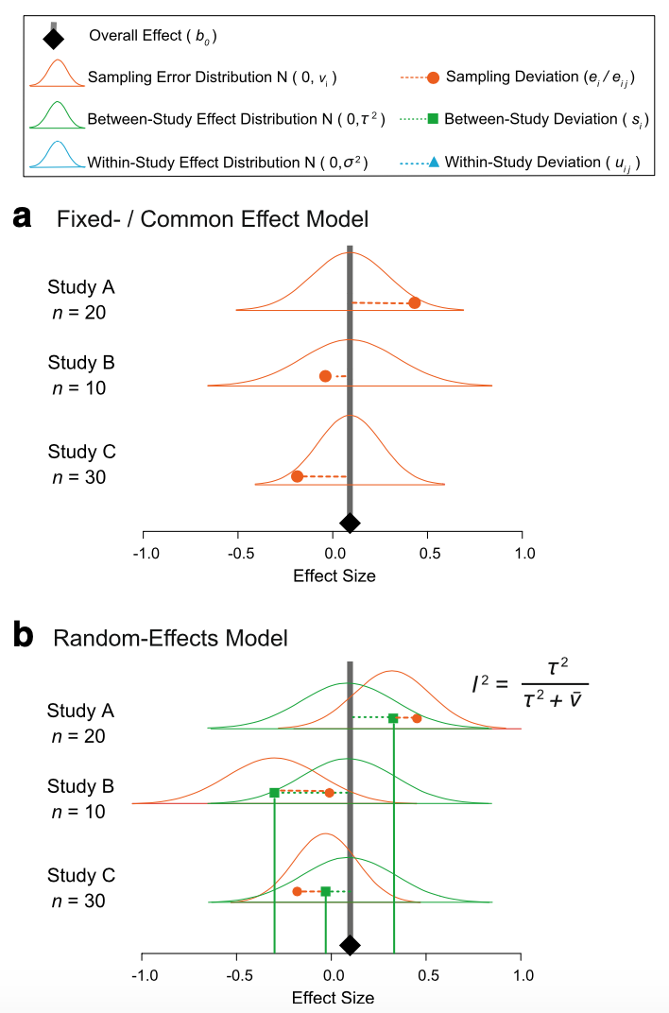
Fixed and random model assumptions
1. Meta-Analysis
Fixed (common) effect
All studies are estimating the same (common) “true” underlying effect
Variability between studies is due to random variation (chance) only

Slide 13
Fixed and random model assumptions
1. Meta-Analysis
Random effects
Each study has different “true” underlying effect
Variability between studies is due to random variation (chance) and actual differences

Slide 14







Fixed (common) and random: it’s just another linear model
1. Meta-Analysis
Fixed-effect meta-analysis
(common-effect meta-analysis)
Random-effects meta-analysis
i = study number; 1 to the total number of studies
m = sampling error for each effect size
y = effect size
s = study-specific effect
u = meta-analytic mean or ‘intercept’
Nakagawa & Santos (2012, Evol Ecol)
Notes:
Need to add more

Slide 15
Fixed (common) and random: it’s just another linear model
1. Meta-Analysis
Fixed-effect meta-analysis
(common-effect meta-analysis)
Random-effects meta-analysis
rnorm(N, 0, sqrt(V))
i = study number; 1 to the total number of studies
m = sampling error for each effect size
y = effect size
s = study-specific effect
u = meta-analytic mean or ‘intercept’
Nakagawa & Santos (2012, Evol Ecol)
Notes:
Need to add more

Slide 16
Fixed (common) effect in code…
1. Meta-Analysis
# Generate some simulated effect size data with known sampling variance # assumed to come from a common underlying distribution set.seed(86) # Set see so that we all get the same simulated results
# We will have 5 studies stdy <- 1:5
# We know the variance for each effect Ves <- c(0.05, 0.10, 0.02, 0.10, 0.09)
# We'll need this later but these are weights W <- 1 / Ves
# We assume they are sampled from a normal distribution with a mean effect size of 2 es <- rnorm(length(Ves), 2, sqrt(Ves))
# Data for our fixed effect meta-analysis dataFE <- data.frame(stdy = stdy, es, Ves)

Slide 17
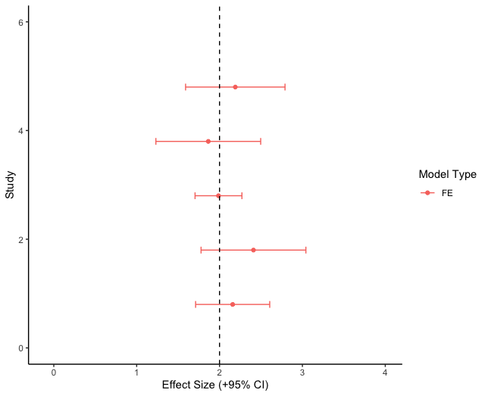
Fixed effects model data…
1. Meta-Analysis

Slide 18
Fixed effect model meta-analysis..
1. Meta-Analysis
# Run a fixed effect meta-analysis using the FE dataset. metafor::rma(yi = es, vi = Ves, method = "FE", data = dataFE)
## ## Fixed-Effects Model (k = 5) ## ## I^2 (total heterogeneity / total variability): 0.00% ## H^2 (total variability / sampling variability): 0.56 ## ## Test for Heterogeneity: ## Q(df = 4) = 2.2340, p-val = 0.6928 ## ## Model Results: ## ## estimate se zval pval ci.lb ci.ub ​ ## 2.0731 0.0994 20.8459 <.0001 1.8782 2.2680 *** ## ## --- ## Signif. codes: 0 '***' 0.001 '**' 0.01 '*' 0.05 '.' 0.1 ' ' 1

Slide 19


Now a fixed effect analysis by hand…
1. Meta-Analysis
We can do all the fancy stuff that metafor is doing ourselves. We just need to know a few simple equations:
Notes:
2.073105 / 0.09944903 gets you the zval
2*pnorm(20.8459, lower.tail = FALSE) gets you the p-value for this

Slide 20
Now a fixed effect analysis by hand…
1. Meta-Analysis
We can do all the fancy stuff that metafor is doing ourselves. We just need to know a few simple equations:
# These are weights W <- 1 / Ves
Notes:
2.073105 / 0.09944903 gets you the zval
2*pnorm(20.8459, lower.tail = FALSE) gets you the p-value for this

Slide 21
Now a fixed effect analysis by hand…
1. Meta-Analysis
We can do all the fancy stuff that metafor is doing ourselves. We just need to know a few simple equations:
Calculate pooled effect size
EsP.FE <- sum(W*dataFE$es) / sum(W)
EsP.FE
## [1] 2.073105
# Calculate the pooled variance around estimate
VarEsP.FE <- 1 / sum(W)
VarEsP.FE
## [1] 0.00989011
# Calculate the standard error around estimate
SE.EsP.FE <- sqrt(VarEsP.FE)
SE.EsP.FE
## [1] 0.09944903
# These are weights W <- 1 / Ves
## estimate se zval pval ci.lb ci.ub ​ ## 2.0731 0.0994 20.8459 <.0001 1.8782 2.2680 ***
Notes:
2.073105 / 0.09944903 gets you the zval
2*pnorm(20.8459, lower.tail = FALSE) gets you the p-value for this

Slide 22
Random effect model in code….
1. Meta-Analysis
# Effect size is sampled from a larger distribution of effect sizes that itself comes from a distribution with a variance of 0.8.
esRE <- rnorm(length(Ves), 2, sqrt(Ves + 0.8))
# Data for our random effect meta-analysis dataRE <- data.frame(stdy = stdy, esRE, Ves)

Slide 23
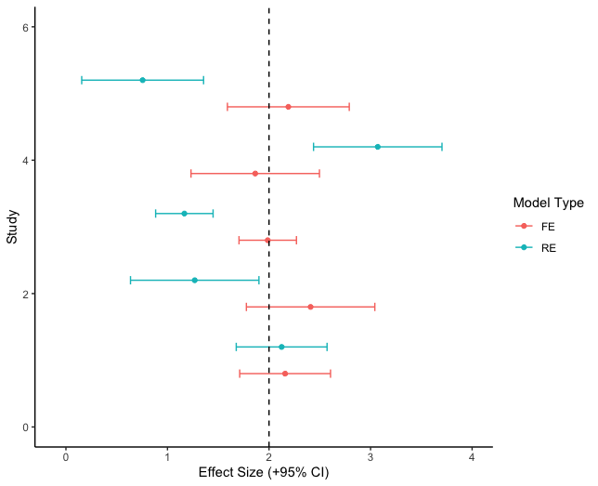
Random effect model data…
1. Meta-Analysis

Slide 24
Random effects model meta-analysis..
1. Meta-Analysis
# Random effect meta-analysis
metafor::rma(yi = esRE, vi = Ves, method="DL", data = dataRE)
## ## Random-Effects Model (k = 5; tau^2 estimator: DL) ## ## tau^2 (estimated amount of total heterogeneity): 0.2947 (SE = 0.2731) ## tau (square root of estimated tau^2 value): 0.5429 ## I^2 (total heterogeneity / total variability): 83.61% ## H^2 (total variability / sampling variability): 6.10 ## ## Test for Heterogeneity: ## Q(df = 4) = 24.4015, p-val < .0001 ## ## Model Results: ## ## estimate se zval pval ci.lb ci.ub ​ ## 2.0163 0.2697 7.4753 <.0001 1.4876 2.5449 *** ## ## --- ## Signif. codes: 0 '***' 0.001 '**' 0.01 '*' 0.05 '.' 0.1 ' ' 1

Slide 25



Now a random effect analysis by hand…
1. Meta-Analysis
We first need to estimate between study variance which can be calculated
where,

Slide 26
1. Meta-Analysis
Now a random effect analysis by hand…
# Calculate our Q statistic again Q <- sum(W*(dataRE$es^2) ) - (sum(W*dataRE$es)^2 / sum(W)) Q
## [1] 24.40149
# Calculate C C <- sum(W) - ((sum(W^2))/sum(W)) C
## [1] 69.23077
# Calculate df & tau2 df <- nrow(dataRE) - 1 T2 <- (Q - df) / C T2
## [1] 0.2946883
## Test for Heterogeneity: ## Q(df = 4) = 24.4015, p-val < .0001
## tau^2 (estimated amount of total heterogeneity): 0.2947 (SE = 0.2731)
Notes:
How to get p-value from Q test, which is a chi-square
2*pchisq(24.40149, 4, lower.tail = FALSE)
[1] 0.0001327126

Slide 27
1. Meta-Analysis
Now a random effect analysis by hand…
Remember, things are the same but the weighting is different now.
# RE weights W.re <- 1 / (T2 + dataRE$Ves) #Pooled effect size for random effect meta-analysis esPoolRE <- sum(W.re*dataRE$es) / sum(W.re) esPoolRE
## [1] 2.016261
# Calculate the pooled variance around estimate VarES <- 1 / sum(W.re) # Calculate the standard error around estimate SE.ES.RE <- sqrt(VarES) SE.ES.RE
## [1] 0.2697219
## estimate se zval pval ci.lb ci.ub ​ ## 2.0163 0.2697 7.4753 <.0001 1.4876 2.5449 ***

Slide 28



More complex meta-analysis: Multilevel meta-analysis
1. Meta-Analysis
Multilevel Meta-analysis
rnorm(Nj, 0, sqrt(sigmaS))
rnorm(Ni, 0, sqrt(sigmaE))
rnorm(Ni, 0, sqrt(V))
i = ith effect size
e = effect-size specific effect
Or = within-study effect
Or = residual
j = jth study

Slide 29



Example
1. Meta-Analysis

Slide 30
Multilevel Meta-analytic Model
1. Meta-Analysis
# Multi-level meta-analytic model MLMA <- metafor::rma.mv(yi= ARR~ 1, V = V_ARR, method="REML", random=list(~1|species_ID, ~1|authors, ~1|es_ID), dfs = "contain", test="t", data=asr_dat) ## Multivariate Meta-Analysis Model (k = 123; method: REML) ## ## Variance Components: ## ## estim sqrt nlvls fixed factor ## sigma^2.1 0.0008 0.0280 29 no species_ID ## sigma^2.2 0.0154 0.1241 21 no authors ## sigma^2.3 0.0097 0.0987 123 no es_ID ## ## Test for Heterogeneity: ## Q(df = 122) = 3941.0055, p-val < .0001 ## ## Model Results: ## ## estimate se tval df pval ci.lb ci.ub ​ ## 0.1668 0.0316 5.2857 20 <.0001 0.1010 0.2327 *** ## ## --- ## Signif. codes: 0 '***' 0.001 '**' 0.01 '*' 0.05 '.' 0.1 ' ' 1

Slide 31
Multilevel Meta-analytic Model
1. Meta-Analysis
# Multi-level meta-analytic model MLMA <- metafor::rma.mv(yi= ARR~ 1, V = V_ARR, method="REML", random=list(~1|species_ID, ~1|authors, ~1|es_ID), dfs = "contain", test="t", data=asr_dat) ## Multivariate Meta-Analysis Model (k = 123; method: REML) ## ## Variance Components: ## ## estim sqrt nlvls fixed factor ## sigma^2.1 0.0008 0.0280 29 no species_ID ## sigma^2.2 0.0154 0.1241 21 no authors ## sigma^2.3 0.0097 0.0987 123 no es_ID ## ## Test for Heterogeneity: ## Q(df = 122) = 3941.0055, p-val < .0001 ## ## Model Results: ## ## estimate se tval df pval ci.lb ci.ub ​ ## 0.1668 0.0316 5.2857 20 <.0001 0.1010 0.2327 *** ## ## --- ## Signif. codes: 0 '***' 0.001 '**' 0.01 '*' 0.05 '.' 0.1 ' ' 1
Overall meta-analytic mean as 0.167
95% confidence interval of 0.101 to 0.233

Slide 32
Quantifying Heterogeneity
2. Heterogeneity Analysis
After estimating meta-analytic means we want to calculate how much variation in effects exists
Why?
Tells us how consistent effects are across studies
Tells us how much variation is the result of sampling error relative to other drivers
Should ALWAYS accompany effect size means

Slide 33


Quantifying Heterogeneity
2. Heterogeneity Analysis
Two common heterogeneity statistics
Cochran’s Q and I²
Q-test only tell us whether there is any heterogeneity but not how much
I² is a useful measure of heterogeneity (it does not depend on the sample size while Q does)
I² is like an effect size statistic
I² = 25, 50 & 75% (low, moderate & high)
k = the number of study = the number of effect size
w = fixed effect weights

Slide 34




Heterogeneity: I² for multilevel models
2. Heterogeneity Analysis
Proportion of variation relative to total
I²_{t(total)} : Proportion of variance among effects after removing sampling variation
t = total
s = study
e = effect size
m = sampling error
Nakagawa & Santos (2012)

Slide 35
2. Heterogeneity Analysis
Heterogeneity: I² for multilevel models
# The orchaRd package has some convenient functions for calculating various I2 estimates including total. We'll load and install that package
#install.packages("pacman")
pacman::p_load(devtools, tidyverse, metafor, patchwork, R.rsp, emmeans, flextable)
#devtools::install_github("daniel1noble/orchaRd", force = TRUE, build_vignettes = TRUE)
library(orchaRd)
orchaRd::i2_ml(MLMA, data = asr_dat)
## I2_Total I2_species_ID I2_study_ID I2_es_ID
## 98.418961 2.982312 58.480574 36.956076

Slide 36
Heterogeneity: Prediction Intervals
2. Heterogeneity Analysis
I² and Q-tests, while useful, don’t always provide intuitive ways to interpret heterogeneity
Prediction intervals really capture effect heterogeneity
Recommend reporting these as they are very easy to understand and really tell you a lot about how much effects vary

Slide 37

Heterogeneity: Prediction Intervals
2. Heterogeneity Analysis
# Calculate the prediction intervals
predict(MLMA)
##
## pred se ci.lb ci.ub pi.lb pi.ub
## 0.1668 0.0316 0.1010 0.2327 -0.1755 0.5091
l.pi.z = 0.1668 - 1.96*sqrt(MLMA$se^2 +sum(MLMA$sigma2))
u.pi.z = 0.1668 + 1.96*sqrt(MLMA$se^2 +sum(MLMA$sigma2))
c(l.pi.z, u.pi.z)
## [1] -0.1548412 0.4884412

Slide 38
Heterogeneity: Prediction Intervals
2. Heterogeneity Analysis
Note: I say ~ (approximately) because we could use a t-statistics (with certain df) and this value gets adjusted for the calculation….

Slide 39
Heterogeneity: Prediction Intervals
2. Heterogeneity Analysis
Calculate the test statistic based on the t-distribution instead of standard normal
# Calculate the prediction intervals
predict(MLMA)
##
## pred se ci.lb ci.ub pi.lb pi.ub
## 0.1668 0.0316 0.1010 0.2327 -0.1755 0.5091
l.pi.t = 0.1668 - qt(0.975, df = 20)*sqrt(MLMA$se^2 +sum(MLMA$sigma2))
u.pi.t = 0.1668 + qt(0.975, df = 20)*sqrt(MLMA$se^2 +sum(MLMA$sigma2))
c(l.pi.t, u.pi.t)
## [1] -0.1755121 0.5091121

Slide 40
Heterogeneity: Prediction Intervals
2. Heterogeneity Analysis
Calculate the test statistic based on the t-distribution instead of standard normal
# Calculate the prediction intervals
predict(MLMA)
##
## pred se ci.lb ci.ub pi.lb pi.ub
## 0.1668 0.0316 0.1010 0.2327 -0.1755 0.5091
l.pi.t = 0.1668 - qt(0.975, df = 20)*sqrt(MLMA$se^2 +sum(MLMA$sigma2))
u.pi.t = 0.1668 + qt(0.975, df = 20)*sqrt(MLMA$se^2 +sum(MLMA$sigma2))
c(l.pi.t, u.pi.t)
## [1] -0.1755121 0.5091121
What do the prediction intervals tell us about our overall meta-analytic mean?

Slide 41
How might we write up our results?
1. Meta-analysis 2. Heterogeneity Analysis
# Multi-level meta-analytic model MLMA <- metafor::rma.mv(yi= ARR~ 1, V = V_ARR, method="REML", random=list(~1|species_ID, ~1|authors, ~1|es_ID), dfs = "contain", test="t", data=asr_dat) ## Multivariate Meta-Analysis Model (k = 123; method: REML) ## ## Variance Components: ## ## estim sqrt nlvls fixed factor ## sigma^2.1 0.0008 0.0280 29 no species_ID ## sigma^2.2 0.0154 0.1241 21 no authors ## sigma^2.3 0.0097 0.0987 123 no es_ID ## ## Test for Heterogeneity: ## Q(df = 122) = 3941.0055, p-val < .0001 ## ## Model Results: ## ## estimate se tval df pval ci.lb ci.ub ​ ## 0.1668 0.0316 5.2857 20 <.0001 0.1010 0.2327 *** ## ## --- ## Signif. codes: 0 '***' 0.001 '**' 0.01 '*' 0.05 '.' 0.1 ' ' 1

Slide 42
1. Meta-analysis 2. Heterogeneity Analysis
# Multi-level meta-analytic model MLMA <- metafor::rma.mv(yi= ARR~ 1, V = V_ARR, method="REML", random=list(~1|species_ID, ~1|authors, ~1|es_ID), dfs = "contain", test="t", data=asr_dat) ## Multivariate Meta-Analysis Model (k = 123; method: REML) ## ## Variance Components: ## ## estim sqrt nlvls fixed factor ## sigma^2.1 0.0008 0.0280 29 no species_ID ## sigma^2.2 0.0154 0.1241 21 no authors ## sigma^2.3 0.0097 0.0987 123 no es_ID ## ## Test for Heterogeneity: ## Q(df = 122) = 3941.0055, p-val < .0001 ## ## Model Results: ## ## estimate se tval df pval ci.lb ci.ub ​ ## 0.1668 0.0316 5.2857 20 <.0001 0.1010 0.2327 *** ## ## --- ## Signif. codes: 0 '***' 0.001 '**' 0.01 '*' 0.05 '.' 0.1 ' ' 1
On average, across female ectotherms, for every 1℃ increase in acclimation temperature heat tolerance increases by 0.167℃
We are 95% confident that the true mean falls between 0.101℃ and 0.233℃
We do have a significant amount of heterogeneity among effects (Q = 3941, df = 122, p = <0.001), with effect sizes expected to be as low as -0.176℃ to as high as 0.509℃ 95% of the time (I²_{total} = 98.41%). Differences among studies and species explain 58% and 3% of effect size variation, respectively.

Slide 43
1. Meta-analysis 2. Heterogeneity Analysis
# Multi-level meta-analytic model MLMA <- metafor::rma.mv(yi= ARR~ 1, V = V_ARR, method="REML", random=list(~1|species_ID, ~1|authors, ~1|es_ID), dfs = "contain", test="t", data=asr_dat) ## Multivariate Meta-Analysis Model (k = 123; method: REML) ## ## Variance Components: ## ## estim sqrt nlvls fixed factor ## sigma^2.1 0.0008 0.0280 29 no species_ID ## sigma^2.2 0.0154 0.1241 21 no authors ## sigma^2.3 0.0097 0.0987 123 no es_ID ## ## Test for Heterogeneity: ## Q(df = 122) = 3941.0055, p-val < .0001 ## ## Model Results: ## ## estimate se tval df pval ci.lb ci.ub ​ ## 0.1668 0.0316 5.2857 20 <.0001 0.1010 0.2327 *** ## ## --- ## Signif. codes: 0 '***' 0.001 '**' 0.01 '*' 0.05 '.' 0.1 ' ' 1
On average, across female ectotherms, for every 1℃ increase in acclimation temperature heat tolerance increases by 0.167℃
We are 95% confident that the true mean falls between 0.101℃ and 0.233℃
We do have a significant amount of heterogeneity among effects (Q = 3941, df = 122, p = <0.001), with effect sizes expected to be as low as -0.176℃ to as high as 0.509℃ 95% of the time (I²_{total} = 98.41%). Differences among studies and species explain 58% and 3% of effect size variation, respectively.

Slide 44
1. Meta-analysis 2. Heterogeneity Analysis
# Multi-level meta-analytic model MLMA <- metafor::rma.mv(yi= ARR~ 1, V = V_ARR, method="REML", random=list(~1|species_ID, ~1|authors, ~1|es_ID), dfs = "contain", test="t", data=asr_dat) ## Multivariate Meta-Analysis Model (k = 123; method: REML) ## ## Variance Components: ## ## estim sqrt nlvls fixed factor ## sigma^2.1 0.0008 0.0280 29 no species_ID ## sigma^2.2 0.0154 0.1241 21 no authors ## sigma^2.3 0.0097 0.0987 123 no es_ID ## ## Test for Heterogeneity: ## Q(df = 122) = 3941.0055, p-val < .0001 ## ## Model Results: ## ## estimate se tval df pval ci.lb ci.ub ​ ## 0.1668 0.0316 5.2857 20 <.0001 0.1010 0.2327 *** ## ## --- ## Signif. codes: 0 '***' 0.001 '**' 0.01 '*' 0.05 '.' 0.1 ' ' 1
On average, across female ectotherms, for every 1℃ increase in acclimation temperature heat tolerance increases by 0.167℃
We are 95% confident that the true mean falls between 0.101℃ and 0.233℃
We do have a significant amount of heterogeneity among effects (Q = 3941, df = 122, p = <0.001), with effect sizes expected to be as low as -0.176℃ to as high as 0.509℃ 95% of the time (I²_{total} = 98.41%). Differences among studies and species explain 58% and 3% of effect size variation, respectively.

